Slide 1
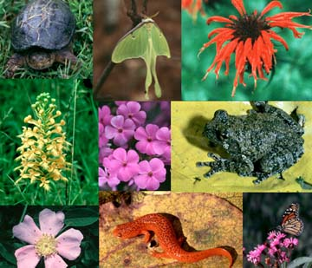
UNIT 3
BIODIVERSITY

Slide 2
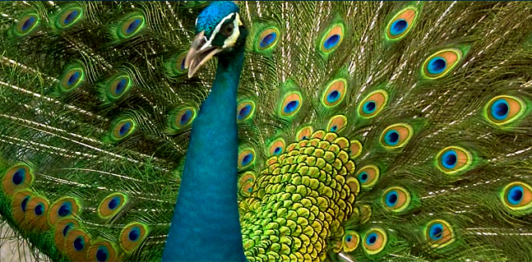
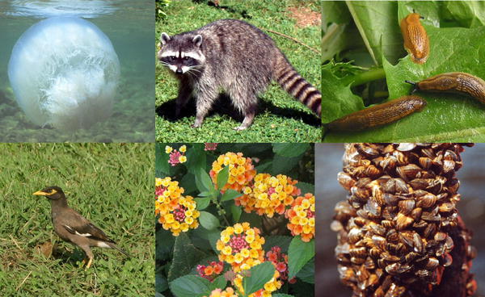
Biodiversity
The term biodiversity is made up of two words - bio and diversity. Bio means living and diversity means variety. So the variety or variability of organisms and ecosystem is referred to as biodiversity.

Slide 3
Types of Biodiversity
Genetic diversity - Diversity of genes within a species, i.e., genetic variability among the populations and the individuals of the same species.
Species diversity- Diversity among species in an ecosystem. ‘Biodiversity hotspots’ are excellent examples of species diversity.
Ecosystem diversity- Diversity at a higher level of organization, i.e., the ecosystem. It concerns the variety of ecosystems on Earth.

Slide 4

Kinds of biodiversity
Genetic Diversity
Variations among the genes of the same species are known as genetic diversity.
It is this type of diversity that gives rise to the different varieties of rice, mangoes,etc.

Slide 5
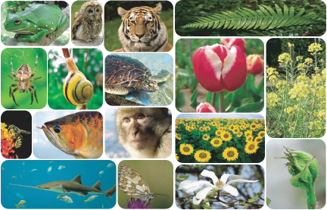
Species Diversity
Diversity which arises due to variations among species present in specific areas is called as ‘species diversity’. Horses and donkeys are distinct species, as are lions and tigers.
.

Slide 6
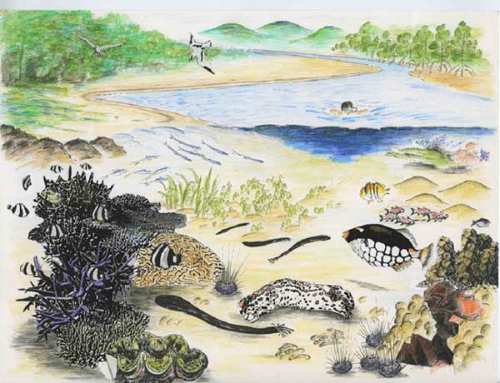
Ecosystem Diversity
Ecosystem diversity is therefore, the diversity of habitats which include the different life forms within. The term also refers to the variety of ecosystems found within a bio geographical political boundary.

Slide 7
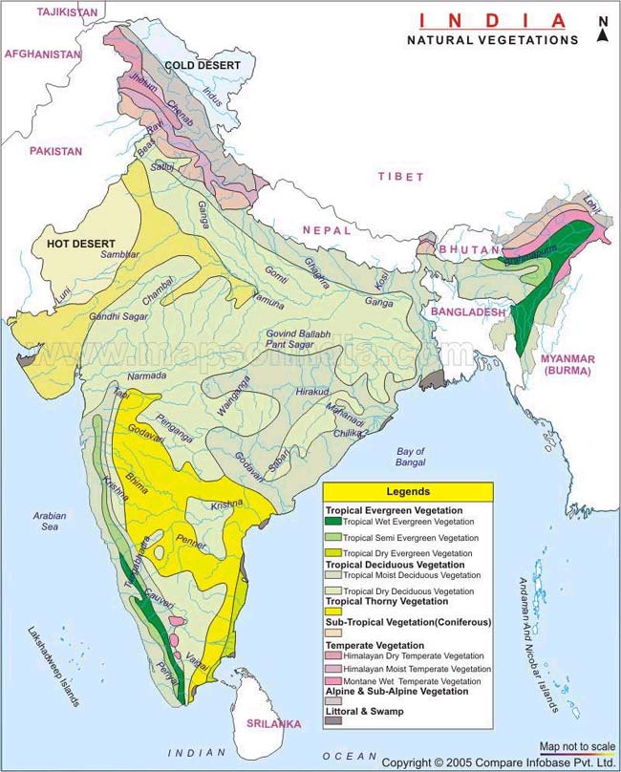
Biogeographical regions of India
The Western Himalayas
    (kashmir to nepal)
The Eastern Himalayas
    (China, sikkim, Bhutan)
Western Deserts
Gangetic Plains
Central India
Western Coast
Deccan Plateau (dry, rocky part in AP
Tamil Nadu karnatak)
North-East India
Andaman and Nicobar Islands

Slide 8
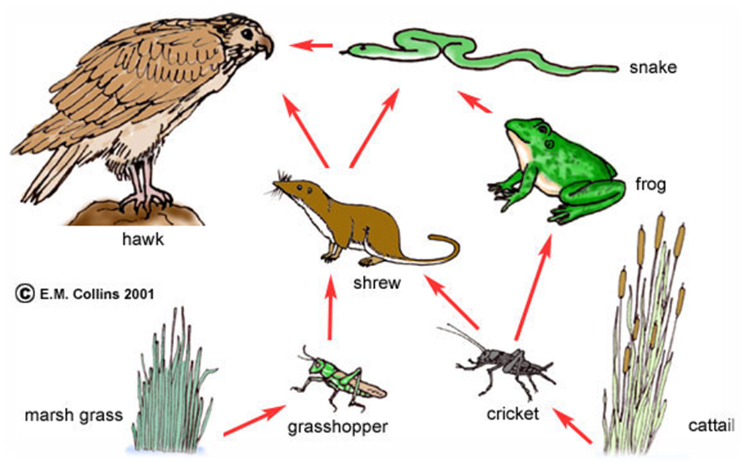
Biodiversity and food web

Slide 9
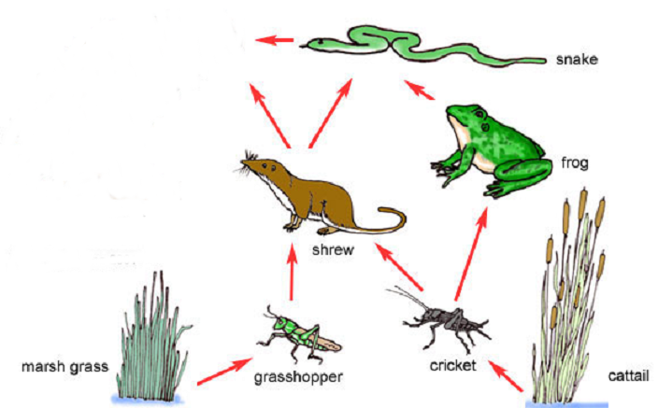
What would happen if a disease killed off many of the hawks?

Slide 10
1. How many biogeographic does India have?
5
6
8
10
2. Lime is generally added to _____ soil
Salty
Dry
Alkaline
Acidic
3. _______ has the maximum genetic diversity in India
Potato
Tea
Mango
Teak
4. _________ is one of the most prevalent hotspots of biodiversity in India
Himalayas
Western Ghats
Ganges
None of the above

